Slide 1

Why “I’m A …” is no longer applicable in the Cloud era
Points to Consider
Rate of change in Technology
Cross skilling is vital
This is your career – Own and manage it
Ryan Yates - @ryanyates1990
User Group co-ordinator for PowerShell User Groups in UK

Slide 2
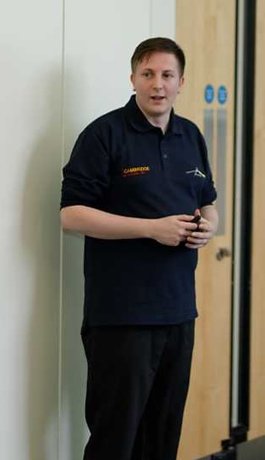
Who Am I?
Ryan Yates – 26 & a Microsoft Cloud & DataCentre Management MVP predominantly focused on Windows 10, PowerShell, Azure & historically SharePoint
Coordinator of Get-PSUGUK – The UK PowerShell User Groups http://www.get-psuguk.org
Co-Organiser of PSConfEU – the Premier PowerShell Conference of the year – http://www.psconf.eu
Technical Director at Re-Digitise – https://www.re-digitise.org
Frequent speaker at SharePoint, SQL, PowerShell and other Technology events Worldwide.
@ryanyates1990

Slide 3

















GOLD SPONSORS
SILVER SPONSORS
BRONZE SPONSORS
SUPPORTERS

Slide 4
So what is it that I actually mean?
We no longer wait years for new product features – Azure as new features released weekly
Pace of change in Technology has dramatically increased.
Completely New Technologies are coming out increasingly more frequently
Machine Learning, Lambda and services like OMS are increasingly more common and accessible
@ryanyates1990

Slide 5
So what is it that I actually mean?
Hand building Servers and applications is a thing of the past i.e Infrastructure as Code / DevOps movements
We need to adopt a different IT Management Lifecycle approach
Scripting, Programming and Development Languages are prominent essentials in most of the job market
More skills are required or advertised in roles than ever before
@ryanyates1990

Slide 6
Quick Poll!
How many of you have started to use on a frequent basis?
PowerShell???
C#
Javascript??
@ryanyates1990

Slide 7

Case Study – Myself
From an early age (8/9) – I knew I wanted to work in IT
@ryanyates1990

Slide 8

Case Study – Myself
My Mum used to think that this would happen if I was to use her computer
@ryanyates1990

Slide 9

Case Study – Myself
At School I took Applied ICT as my Double GCSE Elective
Over the 2 years spent on this course I learnt how to use Excel, Word, Publisher, Frontpage & PowerPoint – Not really “Applied ICT”
There was ZERO code learnt – unless you are a PM then I suppose that you could count Excel formulas ;-)
@ryanyates1990

Slide 10



Case Study – Myself
At 16 I began an unpaid “Apprenticeship” with Zenos IT Academy to attain an MCSE in Server 2003 along with a CCNA and CompTIA Network+
Changes in Personal circumstances led me to have to drop out from the course only 9 months after starting
@ryanyates1990

Slide 11

Case Study – Myself
At 19 & with no on paper IT Experience I managed to secure my first IT role as a Laptop Repair QA technician
Unfortunately it lasted all of 3 weeks
@ryanyates1990

Slide 12
Case Study – Myself
I then had to take a break from trying to get into IT (and generally studying) and just get any form of work as I became a father at 19
@ryanyates1990

Slide 13


Case Study – Myself
At 22 I landed my first real IT Role as an IT Apprentice at Barclays
Within this role I engaged with a number of teams and learnt a tremendous amount of various technologies and global cultures
Most of this engagement was from me to them not them to me.
@ryanyates1990

Slide 14
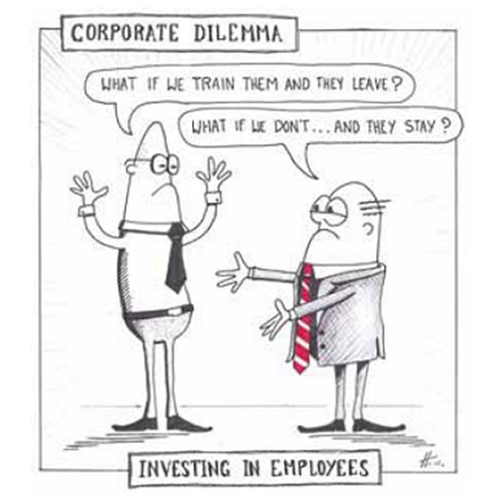
Case Study – Myself
However …..
My training requests were never agreed and in the time there I only received a level of basic training
This is a common theme in organisations
@ryanyates1990

Slide 15

Case Study – Myself
I had realised at this point my career wasn’t going to move in the direction I wanted.
This became more evident after applying for another internal role to be met with the response that I wasn’t the fit required for the role.
So I started to look for other roles elsewhere (on the quiet)
@ryanyates1990

Slide 16

Case Study – Myself
I soon found another role advertised in a different organisation within the Public Sector – specifically Higher Education – that with my experience and skills I felt I was a good fit.
This was difficult as I had become “boxed in” to the role that I was previously doing and wasn’t commonly advertised
@ryanyates1990

Slide 17

Case Study – Myself
So with a new found sense of future potential career growth I had a major sense of enthusiasm.
The joys of having a new and refreshed challenge to tackle!
@ryanyates1990

Slide 18

Case Study – Myself
Again
My training requests were not agreed – this time due to an internal IT Restructuring
Again another common theme in organisations at the moment
@ryanyates1990

Slide 19
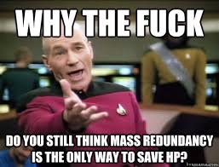

Case Study – Myself
Then came the inevitable
Redundancies
@ryanyates1990

Slide 20

Case Study – Myself
Luckily I had been a constant self learner and throughout this period I had become an active User Group & conference attendee across a number of different technology types.
SharePoint
SQL
LeanAgile
Azure
.Net
PowerShell – Once I started them up
@ryanyates1990

Slide 21
Quick poll
How many of you regularly attend User Group events??
Short Blog Post I put out on finding User Group events https://wp.me/p7f0OS-8j
If not is that due to not knowing about them??
Sign up to Meetup.com (its free)
What about Conferences??
Sign up to Lanyrd.com (its free)
@ryanyates1990

Slide 22
Why does this matter?
UserGroups are typically weekday Evening events with Pizza, 2 talks and are normally free events ran by community leaders
Conferences are typically Weekday Daytime Events & typically are paid for events
SQL Saturday / SharePoint Saturday / PowerShell Saturday events are normally free events that occur on a Saturday (though not always)
User Groups and Conferences like SQL Relay provide unique training opportunities
@ryanyates1990

Slide 23
Why does this matter?
The most important thing about these events is the Networking opportunities that come from them
The People you meet at events like this can become more like family than just friends
Have you heard of #SQLFamily ??
They all provide rich networking opportunities
@ryanyates1990

Slide 24
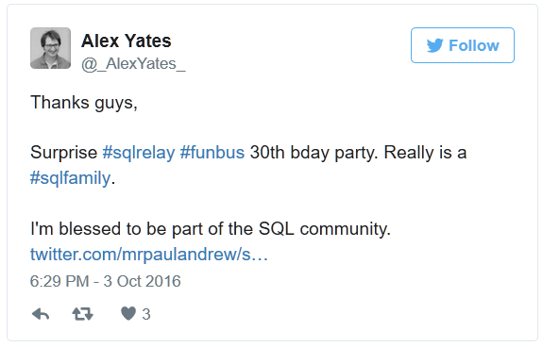
SQLFamily
@ryanyates1990

Slide 25
Social Networking
Twitter
Great to find out new things & Fantastic community
Have got previous roles via tweets
How Many of you use??
LinkedIn
The Professional Social Network
Jobs are often advertised on here early
Conference Networking
Jobs can be given by Word of mouth
Sponsors regularly are also recruiting too
Can be a great place to get almost realtime help or to have off/cross topic conversations
Slack / IRC
@ryanyates1990

Slide 26
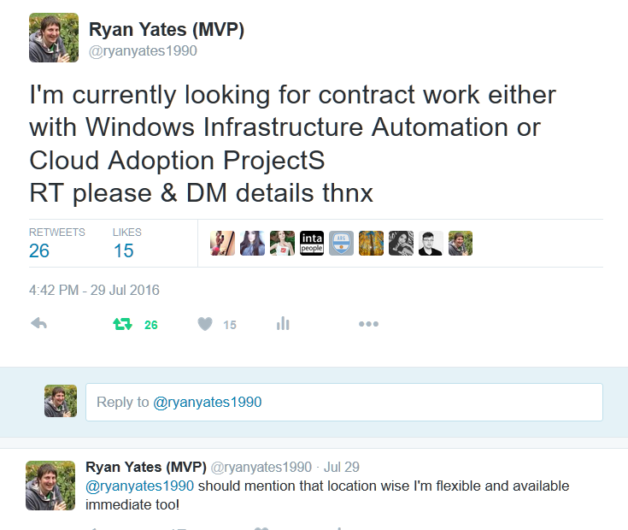
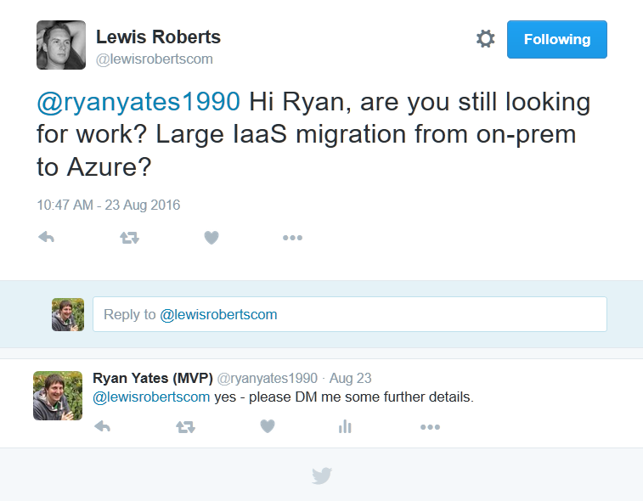
How Twitter landed me a previous contract
@ryanyates1990

Slide 27
Quick poll
How many of you regularly do some form of training out of hours??
We will look at some free & paid Training courses that you can sign up to in a few slides
If not is that due to not knowing about Courses??
@ryanyates1990

Slide 28
Useful tools & offers
For most of these you can use an existing Microsoft account – so @Hotmail.co.uk or @outlook.com
However I would recommend to sign up for a new Microsoft account for these offers
@ryanyates1990

Slide 29
Useful tools & offers
IT Pro Cloud Essentials
https://www.itprocloudessentials.com
For the typical IT Pro this gives
$100 Azure Credit for 3 months (runs out December 31t 2016)
Office 365 and EMS trial subscriptions
Access to some of the Pluralsight Library of training courses
@ryanyates1990

Slide 30
Useful tools & offers
Visual Studio Dev Essentials
https://www.visualstudio.com/dev-essentials/
This gives
3 months access to selected Pluralsight courses
£20 a month (for 12 months) Azure Credit
Access to Visual Studio Team Services – Source Control and Release Management tool set – get in contact with myself or DLM Consultants with further Questions
VSCode and VS Community access (both free downloads)
@ryanyates1990

Slide 31
Useful tools & offers
https://try.github.io/
http://learngitbranching.js.org/
https://Github.com/
www.learnpython.org/
Other useful tools
@ryanyates1990

Slide 32
Useful tools & offers
http://microsoftvirtualacademy.com/
http://www.pluralsight.com/
https://www.wintellectnow.com/
Training Providers
@ryanyates1990

Slide 33
Further Reading
https://blog.kilasuit.org
https://blog.kilasuit.org/2016/03/21/the-power-of-the-humble-pint-and-the-community-when-things-are-difficult/
https://www.troyhunt.com/7-years-of-blogging-and-a-lifetime-later/
https://www.troyhunt.com/how-i-optimised-my-life-to-make-my-job/
@ryanyates1990

Slide 34

Please give us your feedback:
sqlrelay.co.uk/feedback
Thank you
@ryanyates1990

Slide 35
Prize giving is in the Theatre – Head there if you have entered all of the Sponsor Raffles
Thank you
@ryanyates1990

Slide 36
Any Questions??
Feel free to Email me on ryan.yates@re-digitise.org
Or Tweet me at @ryanyates1990
Thank you
@ryanyates1990

